Slide 1
JDP Town Hall

Slide 2
Agenda
Junior Driver Program Review
Introductions and Committee mandate
What have we done? What have we learned?
What happens next?

Slide 3
Agenda
Junior Driver Program Review
Committee Introductions
Committee mandate
  End-to-end review of the program
  Recommendation to SEB/National Office
    SEB/National Office will evaluate and make formal recommendation to BOD
  Execution plan
  Oversight of plan implementation

Slide 4
Timeline
June 10th - JDP Program placed on hold
July 3rd - Formal JDP Review Committee announced
July 7th – JDP Review Committee met every Tuesday
September 29th – JDP Town Hall
Projected:
Early November – Recommendation to BOD
December – BOD decision

Slide 5
Program Review – Understanding
How did we get to the pause?
  Reporting/Review Delays
  Lack of visibility into regional execution
  Questions about program's overall approach to safety
First step was to gather data and frame the issue(s)
  Understand the Reporting/Review Delay – COVID19 impacts
  Review the Incident that caused the questions
  Gather metrics on incidents (SOLO Karts+)
  Build a plan of attack for executing an End-to-End Program Review

Slide 6
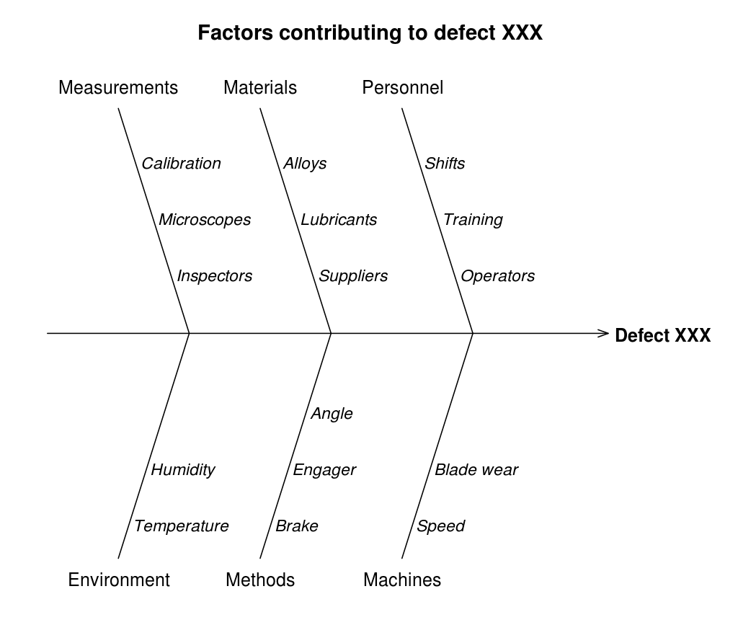
Program Review – Approach
Utilize modified “fishbone” diagram to relate incidents
  Situation – Kid in a Kart on an AutoX course
  People – In what ways do individuals contribute to incidents?
  Process – How do our procedures allow for incidents?
  Machine – How & Why do Kart failures cause incidents?
  Environment – What are the Hazards present at our SOLO Sites?
For each (People/Process/Machine/Environment):
  Group Known/Potential Incidents/Failures
  Review existing Controls/Mitigations
  Identify gaps & propose new

Slide 7
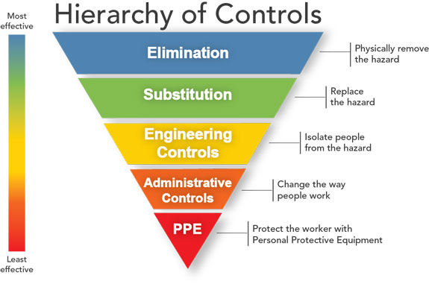
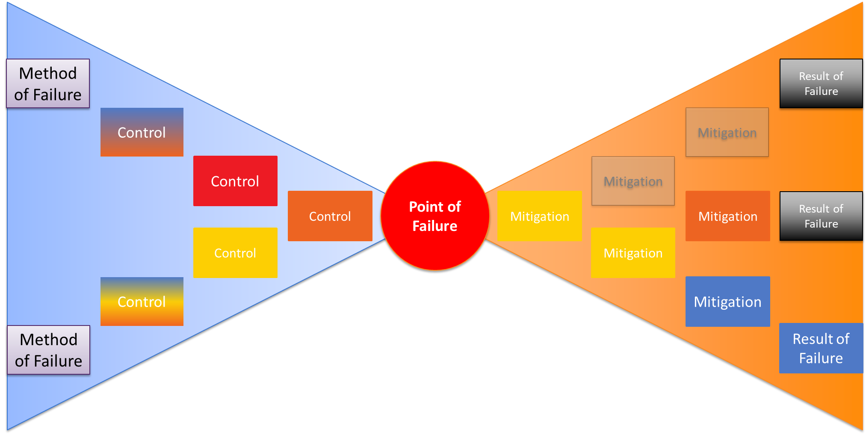
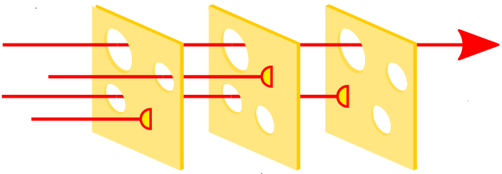
Program Review – Approach Cont.
Review risk profile of Controls vs. Failures potential & Consequences
Utilize Safety Industry standards
  Standard Hierarchy of Controls
  Utilize “Bowtie” Controls/Mitigations
  Multi Barrier “Swiss cheese” safety model
Consolidate into feasible proposal(s)

Slide 8
Program Review – Fishbone
People
Lack of Experience
  Kart Control
  Operation Execution
Lack of Ability to control
  Physical fitment
Pressure to Compete
  Driver, Parent, Officials
Confusion during Abnormal Situations
Process
No tracking of near misses
Lack of “knowledge base”
Inconsistent Operations of Karts (region to region & event to event)
No confidence that existing rules/controls are consistently applied
8

Slide 9
Program Review – Fishbone Cont.
Machine
Stuck Throttle
Inoperable Brakes
Loss of Steering
Snare & Pinch Injuries
Burns
Environment
All sites are different
  Parking lots to airstrips
  Submarine/Clothesline Hazards
  Hard Objects & Upsets
Adverse Track Conditions
Collision with vehicle
Subtility of courses
  Confusing/Lack of definition
  Flying Finishes
9

Slide 10
Program Review – Findings Summary
There are a lot of things we do well
  Our existing program can and DOES prevent the majority of failures
But there are gaps to close
  Consistency in Execution
  Continuous Improvement
  Maintain Multi barrier approach
  Focus on Safety Culture
People
Process
Safety
Machine
Environment

Slide 11
Committee’s Proposals
What are the solutions we are thinking about?

Slide 12
Committee’s Proposals
Old Program:
  Event JPD Steward requirements
    Course Design
    Tech
    Jr Steward
  Basic course safety requirements
    Min distance to objects
    Grid requirements, including no moving cars
  Classes based only on driver age
What didn’t this capture?

Slide 13
Committee’s Proposals
What didn’t this capture?
  Driver skill is not always related to driver age
  New jr drivers had no way to get comfortable and learn skills
  New parents/owners of karts had steep learning curve
  Karts being shared may not “fit” for all drivers
  Regions had many certified Stewards, but few really understood the program
  No re-certification or ongoing oversight for the regional programs

Slide 14
Committee’s Proposals
Sample of Committee Proposals
(pending SEB/BOD discussions)
Jr Driver license program
  every new driver starts with school
  Parents to participate – help learn about equipment/maintenance
  When a driver moves to up a new class, they re-take the school in their new kart
Regional re-certification annually
  Ensures ongoing education of regional stewards

Slide 15
Committee’s Proposals
Sample of Committee Proposals
(pending SEB/BOD discussions)
Divisional Steward site approval
  Ensures sites used for Jr Karts meets the requirements for course and safety
Classes – Structure by experience rather than aged based
  Example: a 14 year old new driver would be eligible for “Jr-B” class (the more restricted engines) for a period of time before being allowed to move up to “Jr-A” class (the less restricted engines)
    In the past, this child would be in JA regardless of experience
  Not proposing changes to current JC class (5-7 year old)

Slide 16
Kart ≠ Car
JDP ≠ Novice Class
FJ Operations are fundamentally different
  Event operation, course design, site selection.
  Kart Tech & Maintenance
    Driver provides 2nd hand info.
Driver Development
  FJ ≠ K1 Speed
New Drivers, New Parents.
  Grow & Share the knowledge base.
  Rules & Regulations only go so far.
  Most regions have less then 3 FJ drivers.

Slide 17
Lack of Consistent Operations
Typically one or two key JDP leaders per region.
  Often a parent of FJ driver
  Limited knowledge/experience with Solo Jr Karters
Regions incorporate individual best practices.
  Built over time from variety of sources including regional experience
  Lots of Tribal Knowledge
    Not routinely reviewed or updated.
    No defined go/no-go criteria.
  Little/no focus on driver development.
Limited continuity between “generations”

Slide 18
Operationalize Community
Best Practices
Define standard operating procedures for all regions to follow.
  Safety as the first criteria.
  Continually updated knowledge base to educate new FJ parents/stewards.
    Minimize region to region operational differences.
  Quickly integrate lessons learned to all regions.
    360 communication post-event.
    Improved transparency in incidents / near-misses
National level oversight to enforce/facilitate communication
Driver Development as key criteria to JDP program.
  Advance as driver is ready.

Slide 19
What is next?
Timeline – Path to a decision
  JDP Townhall – late September
  Review with National Staff & recommendation to BOD – early-November
  BOD decision and plan of attack - December
What 2021 will look like?
  Likely slow rollout to regions
What will we need from the regions and the JDP community?
  Greater member involvement in the management, oversight, and continual improvement of the program

